Slide 1
CSE3001-SOFTWARE ENGNEERING
Module 3
Requirements Process
& Elicitation
Dr . V. Vani, VIT Chennai

Slide 3

What is Requirements?
Describe / Expectations/Need of the customers

Slide 4
Topics to be covered
Synonym of requirements
Need for gathering requirements
Types of requirements
Definition Requirements Engineering(RE)
RE Process and elicitation

Slide 5
Need for gathering requirements
Initial or primary communication between customer/stakeholders and project developers/testers.
Documentation of customer needs without missing .
Requirements gathering should be effective.
Fixing up appointments ,interviewing ,elicitation
and finally documenting.

Slide 6

Problems faced in gathering requirements

Slide 7
Problems faced in gathering requirements
Lack of clarity
Confusion
Amalgamation problem

Slide 8
How to solve the problems faced in gathering requirements
Structured language specification
Requirements should be written in a standard way
Ensure uniformity
Use common templates

Slide 9
Types of requirements (abstract Level)
User requirements
(High level abstraction)
Usually the first attempt for the description of the requirements
Services and constraints of the system
In natural language or diagrams
Readable by everybody
Serve business objectives

Slide 10
Types of requirements (abstract Level)
System requirements
(Detailed description of what the system should do)
Services and constraints of the system in detail
Useful for the design and development
Precise and cover all cases
Structured presentation

Slide 11
System requirements gathering
Function
Description
Inputs
Source
Outputs
Destination
Action
Precondition• Post condition• Side effects

Slide 12
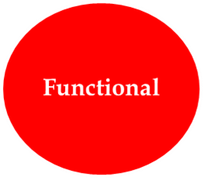
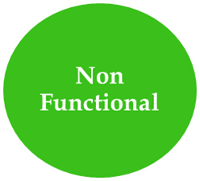
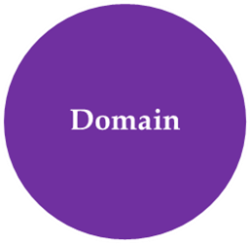
Types of requirements
Types of requirements

Slide 13
What are Functional Requirements
Statement of services the system should provide .
Describe the behaviour in particular situations
Defines the system reaction to particular inputs

Slide 14
What are Non- Functional Requirements
Constraints on the services or functions offered by the system .
Include timing constraints, constraints on the development process and standards .
Apply to system as a whole

Slide 15
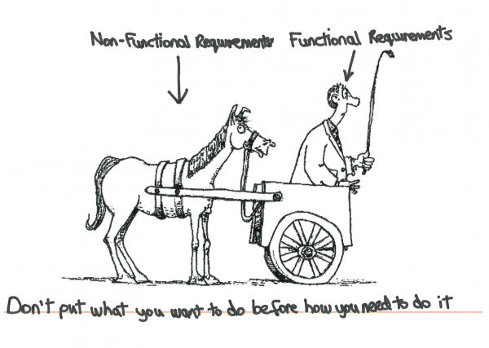
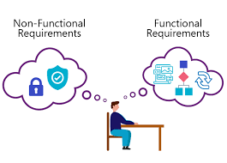

Slide 17

Usability
Efficiency
Reliability
Portability
Product
Procedure and Policies
Delivery
Implementation
Standard
Non functional
requirements
Organizational
External
Obtained from external factors
Interoperability
Ethical
Legislative

Slide 18
What are Domain requirements
Requirements relate to specific application of the system .
Reflect characteristics and constraints of that system.

Slide 19
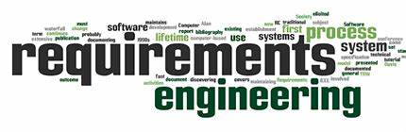
RE is the process of establishing the services that the customer requires from the system and the constraints under which it is to be developed and operated.
The process of finding out, analysing, documenting and checking the services and constraints is called requirement engineering.

Slide 20
Requirements Engineering Process
Processes used to discover, analyse and validate system requirements
Generic activities common to all processes
Requirements elicitation
Requirements analysis
Requirements validation
Requirements management

Slide 21
Requirements Engineering (RE)Process

Slide 22
Requirements Engineering Tasks
Inception
Elicitation
Elaboration
Negotiation
Specification
Validation
Requirements
Management

Slide 23
Requirement Engineering
INCEPTION
A start up step .
To establish a groundwork/ basic understanding of the problem, who need the solution which should be satisfying their needs.
An effective preliminary communication and collaboration between the stakeholders and the software development /testing team.

Slide 24
Requirement Engineering
ELICITATION
Problems of scope - The boundary of the system is ill-defined or the customers/users
Problems of understanding - Needs of other customers/users, ambiguity
Problems of volatility- The requirements change over time.

Slide 25
Requirement Engineering
ELABORATION
Requirements been gathered from the customer (inception and elicitation) is detailed and refined during elaboration.
Output of this step/stage is document of a refined requirements model that depicts the software function, behaviour, and information

Slide 26
Requirement Engineering
NEGOTATION
This stage is active to attain the agreement when there is disagreement on requirements.
To avoid rework and down cost of business.
To avoid conflicting requirements

Slide 27
Requirement Engineering
SPECIFICATION
Converion of gathered requirements to computer-based systems, software, in terms of system specification.
Specification in form written document,
a set of graphical models,
a formal mathematical model,
a collection of usage scenarios,
a prototype,
Or any combination of above

Slide 28
Requirement Engineering
VALIDATION
Ensuring the correctness of requirements and system defined by the customers
Checking the issues related to requirements documented .
Detection and rectifying inconsistencies, omissions, and errors
To conform to the standards for the process, the project, and the product,

Slide 29
In general RE means……

Slide 30
In general RE means……

Slide 31
The Requirements Analysis process
Generic model: each organization has its own version

Slide 32
SUMMARY
In short , this lecture has
Shown light on what is requirements.
How to gather the requirements.
Requirements Engineering Process .
Activities/tasks in RE.

Slide 33
HOTS Questions
Different ways of gathering requirements.
Jacobson's format of software requirements documentation.

Slide 34
CSE3001- SOFTWARE ENGNEERING
Module 3
MODELLING – REQUIREMENTS
Prof Alok Chauhan, VIT Chennai

Slide 35
Topics to be covered
System Modeling
Scenario-based modeling
Data modeling and class-based modeling
Flow-oriented modeling and behavioral modeling
Requirements Specification
Requirement Validation

Slide 36
System Modeling
Requirement/Analysis models are generated during elaboration phase of requirement engineering process.

Slide 37
Requirement models or analysis models capture requirement of the customers along three dimensions (Fig. 1):
Information
Function
behavior
These models focus on what, and not how aspects of customer requirements

Slide 38
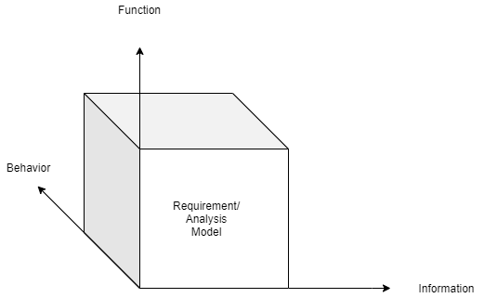
Fig. 1 Requirement/Analysis Model

Slide 39
These models have their origins in system specification created during requirement elicitation phase of requirement engineering process and lead to creation of design models (Fig. 2).

Slide 40
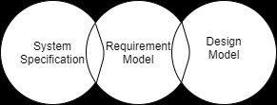
Fig. 2 Scope of Requirement Model

Slide 41
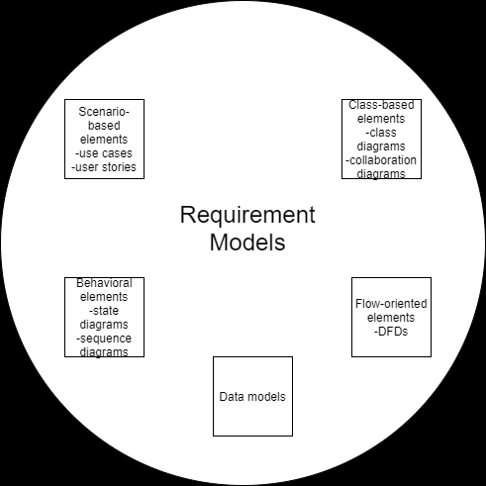
Fig. 3 Elements of requirement model

Slide 42
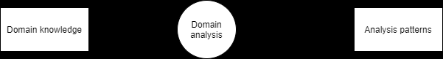
Fig. 4 Domain Analysis
Domain Analysis
Identifying analysis patterns

Slide 43
Requirements Modeling Approaches
Structured analysis
Object-oriented analysis

Slide 44
Scenario-based modeling
Scenarios(UML)
use cases
activity diagrams
swim lane diagrams

Slide 45
Use Case
To begin developing a set of use cases, list the functions or activities performed by a specific actor
SecureHome application
homeresident actor
Access camera over internet
Set up application parameters
Handle alarm

Slide 46
Use Case Componentss
The use case has three components.
The use case task referred to as the use case that represents a feature needed in a software system.
The actor(s) who trigger the use case to activate.
The communication line to show how the actors communicate with the use case.

Slide 47
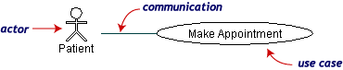
Use Cases
The picture below is a Make Appointment use case for the medical clinic.
The actor is a Patient. The connection between actor and use case is a communication association (or communication for short).
Actors are stick figures. Use cases are ovals. Communications are lines that link actors to use cases.
Actors are stick figures. Use cases are ovals. Communications are lines that link actors to use cases.
Actors are stick figures. Use cases are ovals. Communications are lines that link actors to use cases.

Slide 48
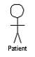
Use Case - Relationships
Boundary
A boundary rectangle is placed around the perimeter of the system to show how the actors communicate with the system.
Make
Appointment
Notes:
System boundary: A system boundary defines the scope of what a system will be. A system cannot have infinite functionality. So, it follows that use cases also need to have definitive limits defined. A system boundary of a use case diagram defines the limits of the system. The system boundary is shown as a rectangle spanning all the use cases in the system.
Other use cases in this lecture also show the system boundary of the clinic application. The use cases of this system are enclosed in a rectangle. Note that the actors in the system are outside the system boundary.
The system boundary is potentially the entire system as defined in the problem statement. But this is not always the case. For large and complex systems, each of the modules may be the system boundary. For example, for an ERP system for an organization, each of the modules such as personnel, payroll, accounting, and so forth, can form the system boundary for use cases specific to each of these business functions. The entire system can span all of these modules depicting the overall system boundary.

Slide 49
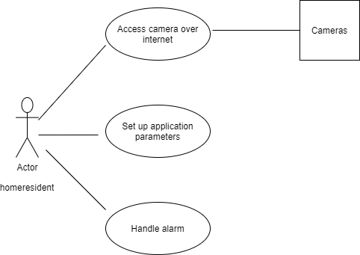
Fig. 5 Secure Home application use cases

Slide 50
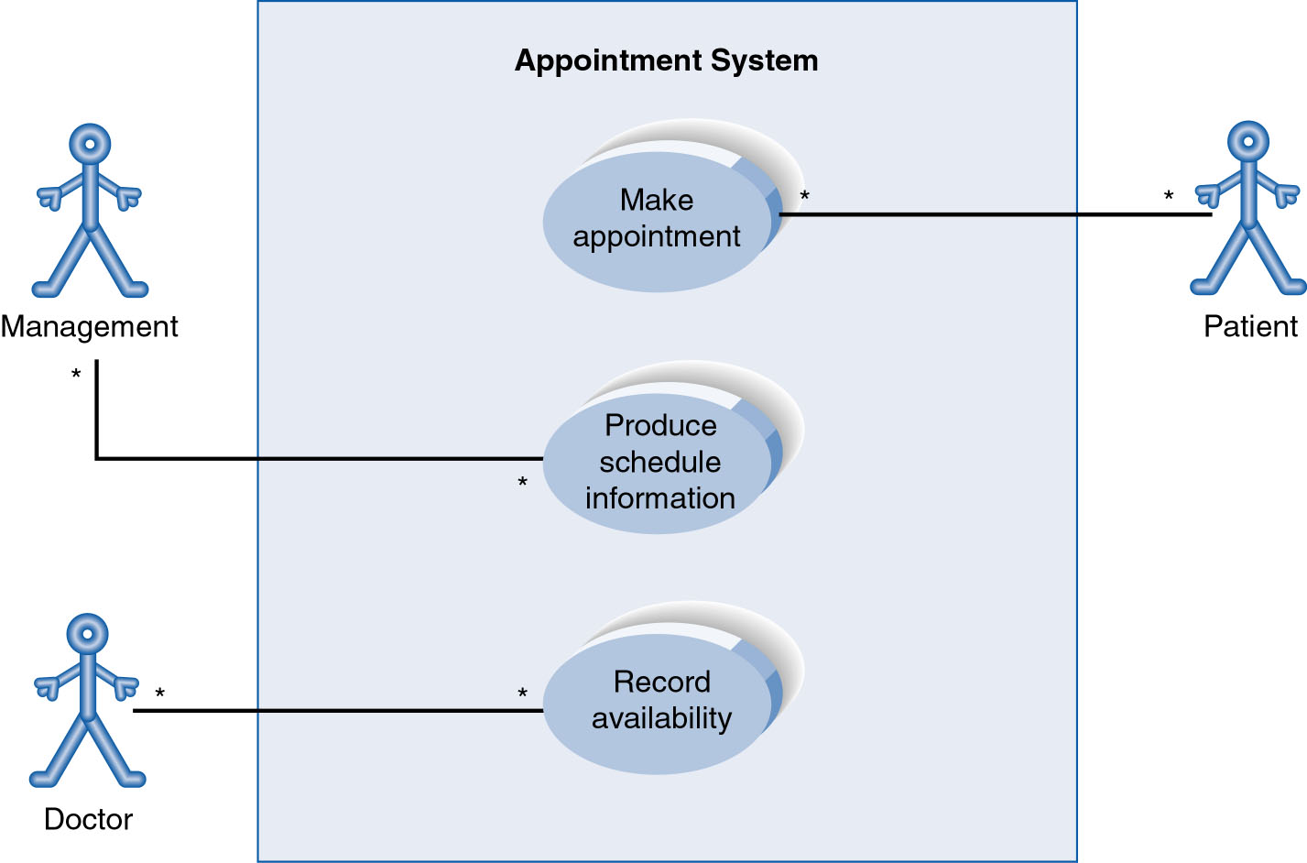
Use-Case Diagram
A use case diagram is a collection of actors, use cases, and their communications.
Notes:
Example Use Case
ACTORS
Represented by a stick figure
named
USE CASE
Represented by an oval
Named (POORLY NAMED; should be verb phrase)
RELATIONSHIP
2-way association

Slide 51
Components of Use Case Diagram
Generalization Relationship
Represented by a line and a hollow arrow
From child to parent
Child use case
Parent use case
Notes:
Inheritance
A use case generalization shows that one use case is simply a special kind of another.
A clinic may have a use case such as Pay Bill which would be a parent use case and Bill Insurance which is the child.
A child can be substituted for its parent whenever necessary.
Generalization appears as a line with a triangular arrow head toward the parent use case.

Slide 52
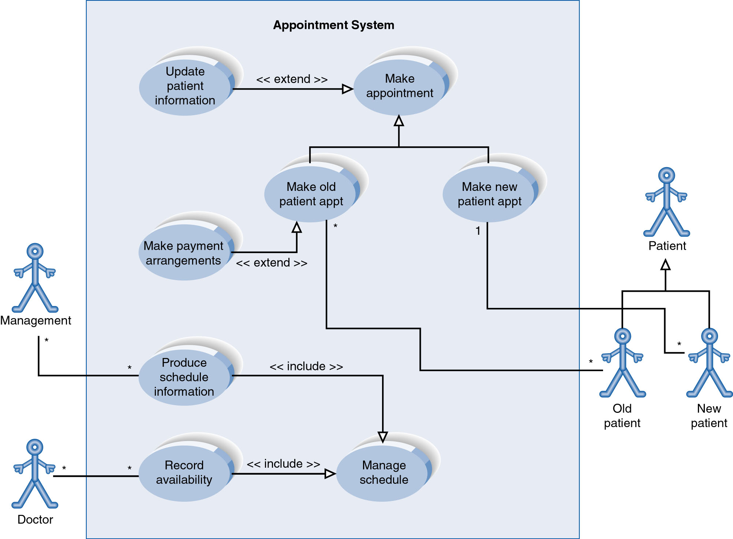
Example of Relationships
Notes:
System Boundary
Use cases are enclosed within a system boundary
a box that represents the system and clearly delineates what parts of the diagram are external or internal to it
Name of the system can appear inside or on top of the box

Slide 53
Use Case Diagram
Include Relationship
Represents the inclusion of the functionality of one use case within another
Arrow is drawn from the base use case to the used use case
Write << include >> above arrowhead line
Notes:
Include relationship
Notice that ONLY between use cases (not between actors)
MANDATORY functional
Multiple use cases may share pieces of the same functionality
Rather than have duplicate functionality in several use cases
Put shared functionality in one use case and show relationship between it and other use cases that “uses” its functionality
Depicted by arrowhead with word “<<include>>” above it
Include relationships factor use cases into additional ones.
Includes are especially helpful when the same use case can be factored out of two different use cases.
If a clinic had a cases of Make Appointment and Request Medication.
Both might include Check Patient Record as a subtask.
Both would include a call to the use case Check Patient Record.
We don’t want to write it twice we simply want to include in as a call from both.
In the diagram,
include notation is a dotted line beginning at base use case ending with an arrows pointing to the include use case.
The dotted line is labeled <<include>>.

Slide 54
Use Case Diagram
Extend relationship
Represents the extension of the use case to include optional functionality
Arrow is drawn from the extension use case to the base use case
Write << extend >> above arrowhead line
Notes:
Use Case Relationship
Extend relationship
Used to show optional behavior (behavior that is run only under certain circumstances)
Depicted by arrowhead with word “<<extend>>” above it
An extend relationship indicates that one use case is a variation of another.
This is often used when much of the same code may be in both only one extends the functionality somewhat.
A typical example is a add record to the database and modify that record.
So an add student is similar to a modify student so I may reuse some of the code.
Extend notation is a dotted line, labeled <<extend>>, and with an arrow toward the base case.
The extension point, which determines when the extended case is appropriate, is written inside the base case.

Slide 56
Activity Diagram
UML activity diagram augments the use case by providing a graphical view of flow of events in a use case

Slide 57


Activity Diagram…
Activity diagrams represent the dynamic (behavioral) view of a system.
Activity diagrams are typically used for business (transaction) process modeling and modeling the logic captured by a single use-case or usage scenario.
Activity diagram is used to represent the flow across use cases or to represent flow within a particular use case.
UML activity diagrams are the object oriented equivalent of flow chart and data flow diagrams in function-oriented design approach.
Activity diagram contains activities, transitions between activities, decision points, synchronization bars, swim lanes and many more…

Slide 58


Activity Diagram…
Describes how activities are coordinated.
Is particularly useful when you know that an operation has to achieve a number of different things, and you want to model what the essential dependencies between them are, before you decide in what order to do them.
Records the dependencies between activities, such as which things can happen in parallel and what must be finished before something else can start.
Represents the workflow of the process.

Slide 59
An activity diagram is very similar to a flowchart.
Flowcharts were typically invented earlier than activity diagrams. Non programmers use Flow charts to model workflows
programmers use activity diagrams (advanced version of a flowchart) to depict workflows. An activity diagram is used by developers to understand the flow of programs on a high level. It also enables them to figure out constraints and conditions that cause particular events.

Slide 60
Difference between a Use case and an Activity diagram
In activity diagram is used to model the workflow depicting conditions, constraints, sequential and concurrent activities. On the other hand, the purpose of a Use Case is to just depict the functionality

Slide 61


Activity Diagram…(Notations)
1. Activity
The Core symbol is used for Activities.
Activity
An activity is some task which needs to be done.
Each activity can be followed by another activity (sequencing).
An activity may be a manual thing, so that it’s not necessarily in a program.

Slide 62

Activity Diagram…(Notations)
2. Transmission (Flow)
When the action or activity of a state completes, flow of control passes immediately to the next action or activity state
The flow of control is shown by arrow symbol.

Slide 63

Activity Diagram…(Notations)
3. Starting and Ending Nodes
The source of flow of control is known as ‘Initial Node or Starting Node’.
Starting Node(Mark)
Destination of flow of control is called ‘Ending Node or Final Node’.
Ending Node

Slide 64



Activity Diagram…(Notations)
4. Join and Fork
Join
A block bar with several flows entering in it and one leaving from it. this denotes the end of parallel activities
4.1 Synch. Bar (Join)
Fork
A black bar ( horizontal/vertical ) with one flow going into it and several leaving it. This denotes the beginning of parallel activities
4.2 Splitting Bar (Fork)

Slide 65
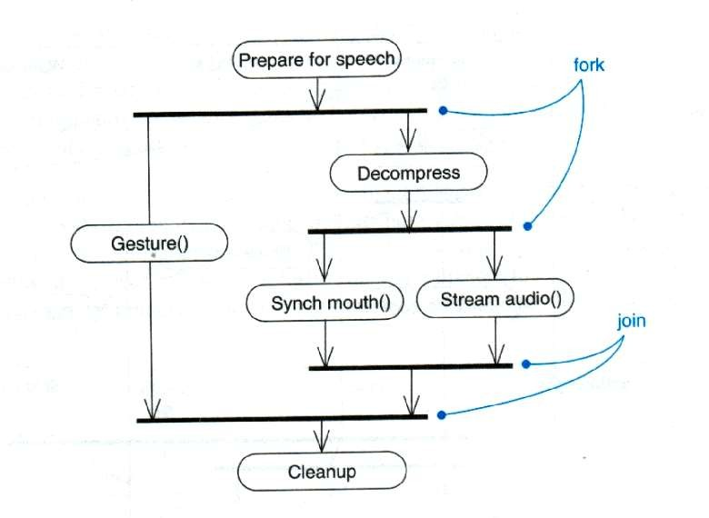
Activity Diagram…(Notations)
Example for Join and Fork

Slide 66


Activity Diagram…(Notations)
5. Decision and Merge
Decision
A diamond with one flow entering and several leaving. The flow leaving includes conditions as yes/ no state.
Merge
A diamond with several flows entering and one leaving. The implication is that all incoming flow to reach this point until processing continues

Slide 67





Activity Diagram…(Notations)
6.Flow Finaland Swimlane
Flow final
– The circle with X though it. This indicates that Process stop at this point
Swim lane
A partition in activity diagram by means of dashed line, called swim lane. This swim lane may be horizontal or vertical
Each zone represents the responsibilities of a particular class or department
Received form
Payment fees
Hostel allotment
Medical check
Issue identity card
Issue library card

Slide 68

Activity Diagram…(Notations)
Difference between Join and Merge
A join is different from a merge in that the join synchronizes two inflows and produces a single outflow. The outflow from a join cannot execute until all inflows have been received
A merge passes any control flows straight through it. If two or more inflows are received by a merge symbol, the action pointed to by its outflow is executed two or more times

Slide 69
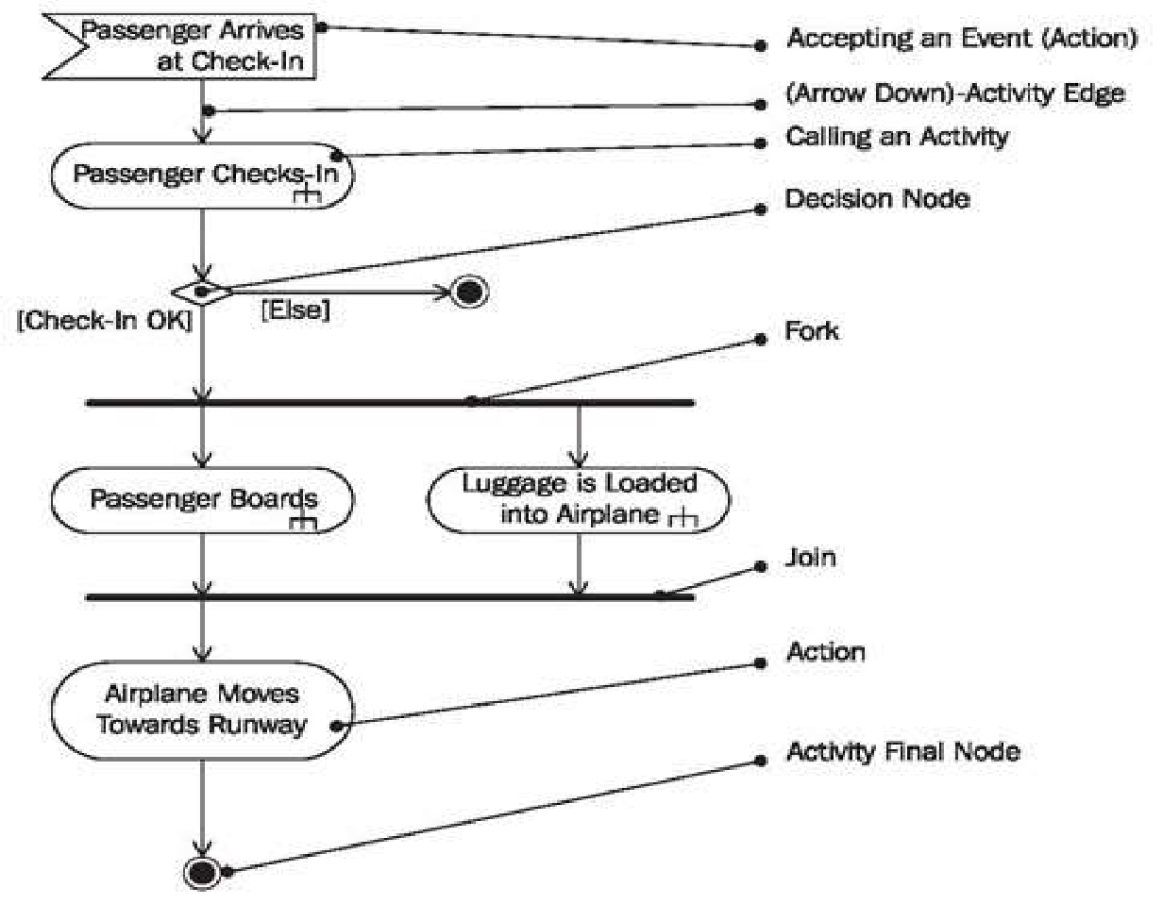
Example of Activity Diagram…

Slide 70







Example of Activity Diagram…
Student
Fill-in form
Verify the
[Found]
[Incorrect]
applications
[Not Found]
Check form
Regret message
Registrar
[Correct]
Display student screen
Create record
System
Input student information
[Match]
1
Search for Student selection list
[No Match]
Regret registration

Slide 71

Drawback of Activity Diagram…
Activity diagrams tell you what is happening, but not who does what.
In domain modelling, this diagram type does not convey which people or departments are responsible for each activity.
In programming, it does not convey which class is responsible for each activity

Slide 72
Example: Business Level Activity Diagram
of the Library
member
Librarian
[borrower]
Find book on shelf
[returning]
[returner]
Wait in queue
[borrowing]
Record return
Put book back of shelf
Record borrowing
Prepare for next
member

Slide 73
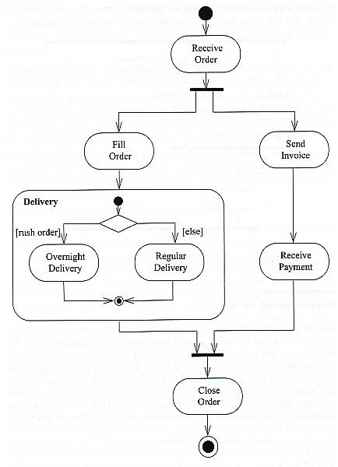
Activity Diagram Example
Fork/Branch
To show concurrent activity, activity diagrams allow branches and joins.
You can also reference or include other activity diagrams
Join
Notes:
Got here Class -- Sept 30th 2008

Slide 74
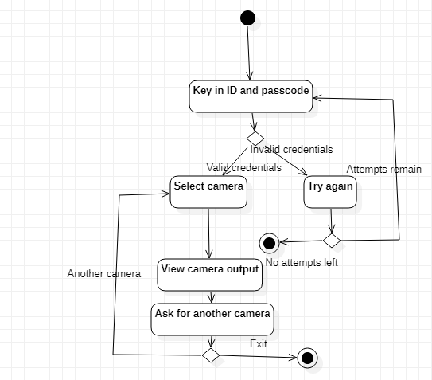
Fig. 6 Activity diagram for Access camera over internet use case

Slide 75
Swimlane Diagrams
The UML swimlane diagram is an extension of the activity diagram and also shows the activities performed by multiple actors.

Slide 76
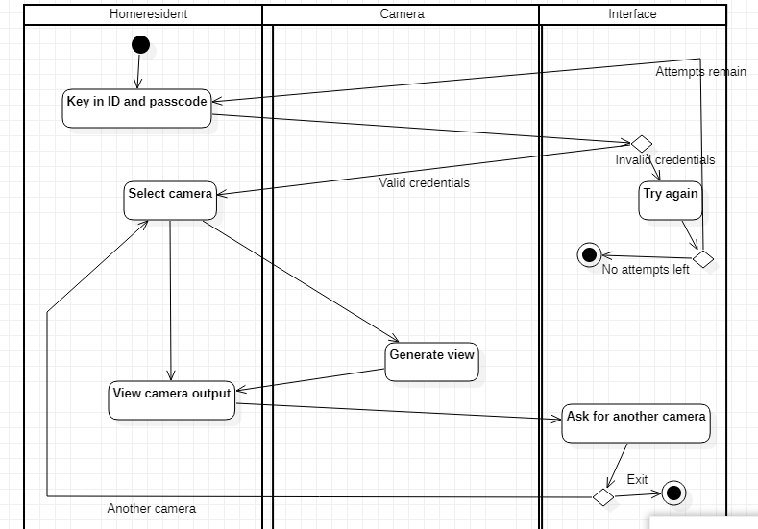
Fig. 7 Swimlane diagram for Access camera over internet use case

Slide 77
DATA MODELING and CLASS-BASED MODELING
Data Modeling
Entity-Relationship Diagram (ERD)
Class-based Modeling
Class diagram

Slide 78
Entity-Relationship diagram (ERD)
Data Objects (Entity)
Entity outside the system
Thing
Event
Role
Organization
Location
Logical entity
Entity
Attributes
Relationships

Slide 79

ID | Make | Model | Type | Color | Owner
C123 | Ford | Aspire | Sedan | Red | SPJ
C124 | Maruti | Baleno | Coupe | Green | TYR
C125 | Fiat | Spider | Sports | Blue | UTR
Fig. 8 Data object tabular representation

Slide 80
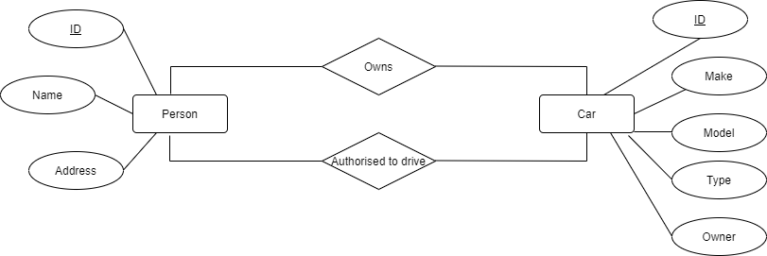
Fig. 9 Entity Relationship diagram

Slide 81
Class Based Modeling
Identifying Analysis Classes
grammatical parse of usage scenarios (noun/noun phrases)
Entity outside the system
Thing
Event
Role
Organization
Location
Logical entity

Slide 82
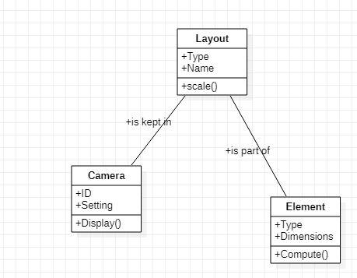
Fig. 10 Class diagram

Slide 83
Classes
Entity classes
Boundary classes
Controller classes

Slide 84
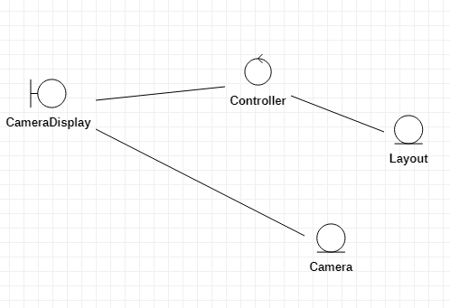
Fig. 11 Class diagram

Slide 85
Class-Responsibility-Collaborator (CRC) Modeling
Class: Layout
Description
Responsibility: | Collaborator:
Define map
Incorporate element | Element
Show location of cameras | Camera
Adjust display
Fig. 12 CRC card

Slide 86
FLOW-ORIENTED MODELING and BEHAVIORAL MODELING
Flow-oriented modeling
Data flow diagram (DFD)
Behavioral modeling
Sequence diagram
State diagram

Slide 87
Data Flow Diagram (DFD)
core modeling activity in structured analysis
Data Flow Diagram (DFD)
“grammatical parse”
nouns (and noun phrases)
external entities (boxes), data or control objects (arrows), or data stores (double lines)
verbs (and verb phrases)
Processes (bubbles)
level 0 DFD or context diagram

Slide 88
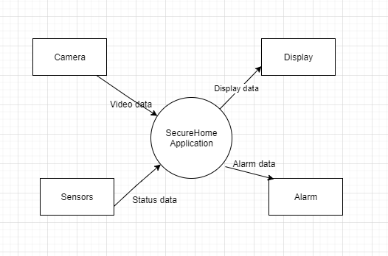
Fig. 13 Context Diagram

Slide 89
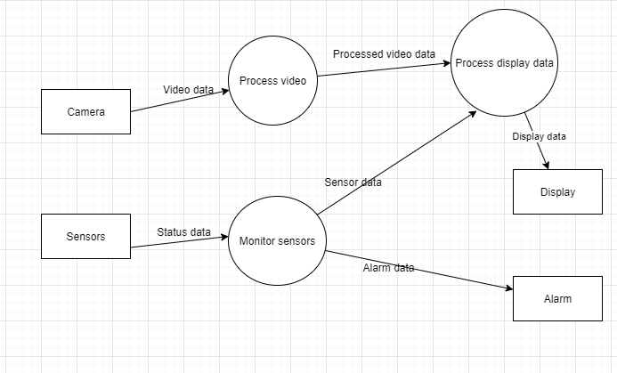
Fig. 14 Level 1 DFD

Slide 90
BEHAVIORAL MODEL
dynamic behavior of the system
Sequence diagrams for the Use Cases
Identifying Events corresponding to a use case
State diagrams for analysis classes
Identifying active states for each class and the events (triggers) that cause changes between these active states

Slide 91
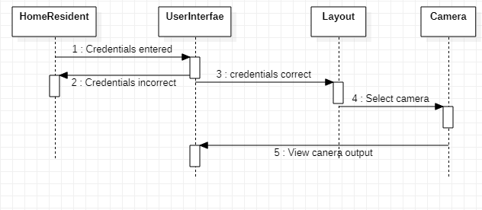
Fig. 15 Sequence Diagram (Accessing camera over internet )

Slide 92
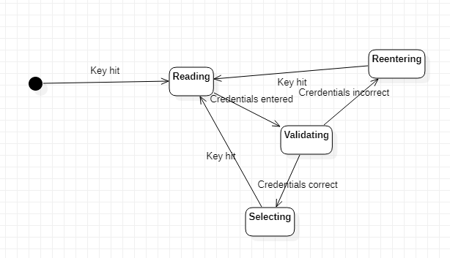
Fig. 16 State diagram (User Interface)

Slide 93
Requirements Specification and Requirement Validation
Software requirements specification (SRS)
Requirement Validation

Slide 94
Software Requirements Specification (SRS)

Slide 95
Requirements validation
Concerned with demonstrating that the requirements define the system that the customer really wants.
Requirements error costs are high so validation is very important
Fixing a requirements error after delivery may cost up to 100 times the cost of fixing an implementation error.

Slide 96
Requirements checking
Validity. Does the system provide the functions which best support the customer’s needs?
Consistency. Are there any requirements conflicts?
Completeness. Are all functions required by the customer included?
Realism. Can the requirements be implemented given available budget and technology
Verifiability. Can the requirements be checked?

Slide 97
Requirements validation techniques
Requirements reviews
Systematic manual analysis of the requirements.
Prototyping
Using an executable model of the system to check requirements.
Test-case generation
Developing tests for requirements to check testability.

Slide 98
Requirements reviews
Regular reviews should be held while the requirements definition is being formulated.
Both client and contractor staff should be involved in reviews.
Reviews may be formal (with completed documents) or informal. Good communications between developers, customers and users can resolve problems at an early stage.

Slide 99
Review checks
Verifiability
Is the requirement realistically testable?
Comprehensibility
Is the requirement properly understood?
Traceability
Is the origin of the requirement clearly stated?
Adaptability
Can the requirement be changed without a large impact on other requirements?

Slide 100
HOTS question
You are hired to develop a software system for motion detection and garage door control. The system should turn the garage door lights on automatically when it detects motion within a given perimeter. It should be possible to control the garage door opener either by a remote radio transmitter or by a manual button switch. The opener should include the following safety feature. An “electric eye” sensor, which projects invisible infrared light beams, should be used to detect if someone or something passes under the garage door while it closes. If the beam is obstructed while the door is going down, the door should not close and the system should automatically stop and reverse the door movement. You only need to develop a software system that controls the hardware components.
What would be the outcome of requirement analysis process for the given scenario? Explain with the help of suitable models.

Slide 101
Summary
Requirement elaboration/analysis process results in creation of various types of models such as scenario- based, Class-based, Behavioral-based, Flow-oriented and Data models
Scenario-based models represent software requirements from the point of view of user
Data modeling takes care of information space associated with the software
Class-based modeling helps us identify analysis classes
Flow-oriented models focus on how input is transformed into output as data objects flow in a system
Behavioral modeling highlights dynamic behavior of the system
Software requirements specification (SRS) document is an agreed statement of the software requirements
Requirements validation is the process of checking the software requirements for validity, consistency, completeness, realism, and verifiability

Slide 102
THANK YOU……..

